Slide 1
Bengal TO Bangladesh
The land, the people and the geography

Slide 2
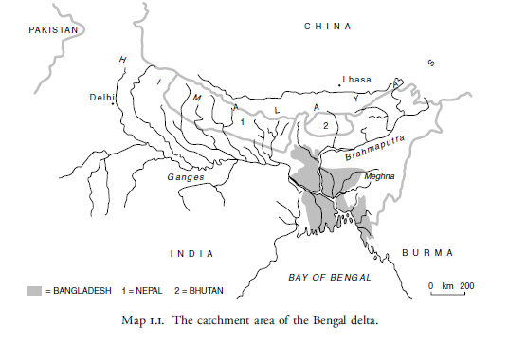
The Bengal Delta – developed a very distinct regional identity;

Slide 3
Monsoon – Rain
Cyclones
Floods – Flash Floods – floodplains dominate life in Bangladesh – they cover 80 per cent of the country;
The natural environment has significant impact on individual life and the nature of society;

Slide 4
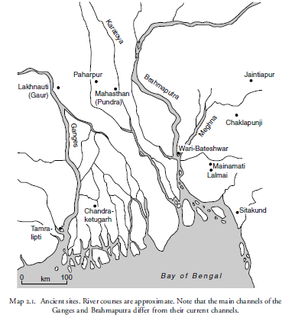
Map showing some oldest cities

Slide 5
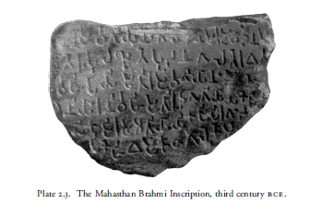
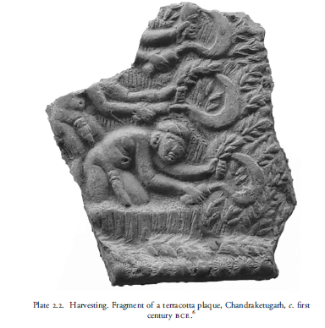
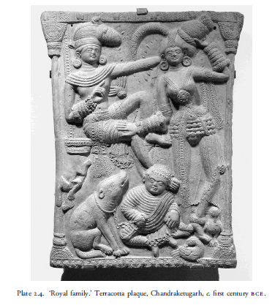
The Maurya (324 -187 BCE)

Slide 6
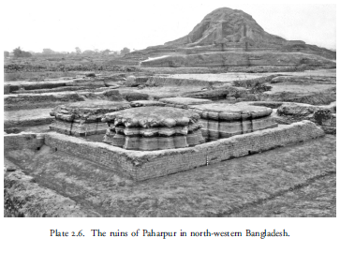
Paharpur 8th Century- The Gupta and Pala Empire

Slide 7
The religious and state frontier
Hinduism
Islam
Establishment of the Muslim Rule
The establishment of the Mughal Empire – most of present day Indian sub-continent was brought under single authority;
Arrival of the Europeans
Battle of Palashi/Plassey and the beginning of the British Rule

